Slide 1

THOUGHTBUBBLE
Overview
Tasks
Revised Interface Design
Prototype Overview

Slide 2
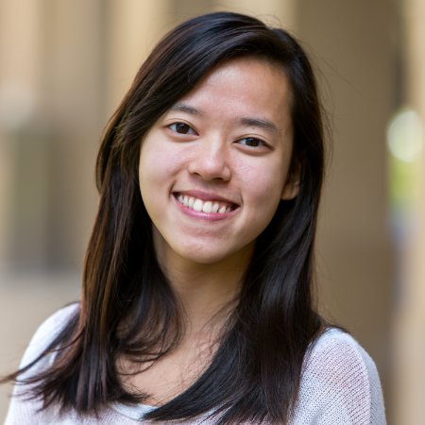
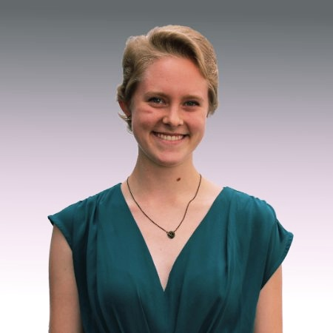
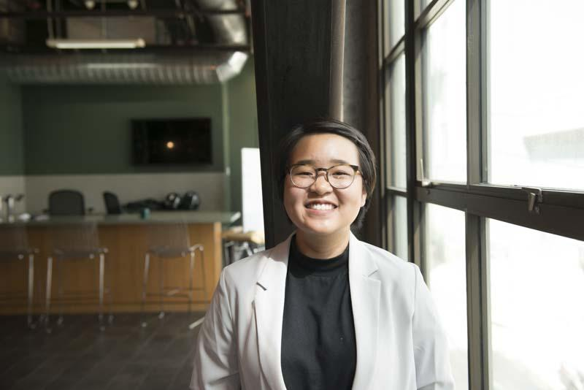
TEAM MEMBERS
Po Tsui
Bonnie Nortz
Jenny Kim
Grace Hong

Slide 3
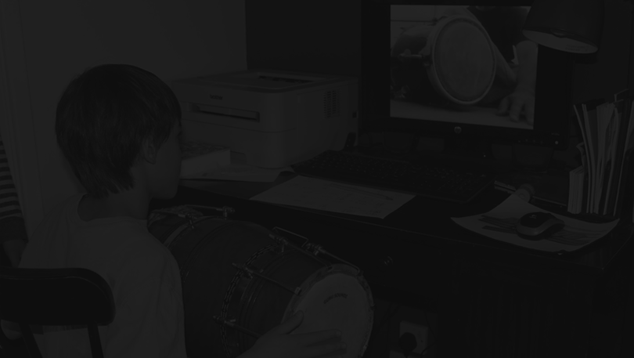
GET HELP TALKING
ABOUT THE TOUGH QUESTIONS. EXPAND YOUR BUBBLE
VALUE PROPOSITION
PROBLEM & SOLUTION
People often find it difficult to have conversations about identity or personal experience. For the most part, they fear not knowing how to ask these questions in a sensitive manner, or worry about offending and indirectly hurting others.
We propose a solution that helps people to be forthcoming about identities and experiences they’re willing to share, guide their friends in framing tough questions, and facilitate a larger conversation across multiple identities.

Slide 4
TASK DEFINITION
TASK 1 | ASK AN ANONYMOUS QUESTION (SIMPLE)
TASK 2 | ANSWER/CRITIQUE A QUESTION (COMPLEX)
TASK 3 | REFLECT ON WHAT YOU LEARNED (MODERATE)

Slide 5
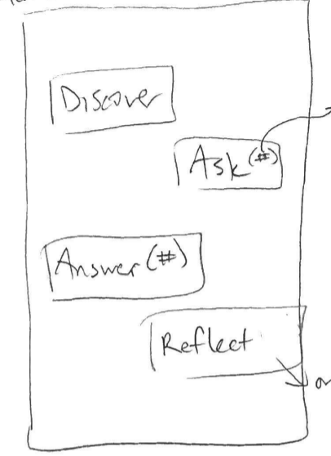
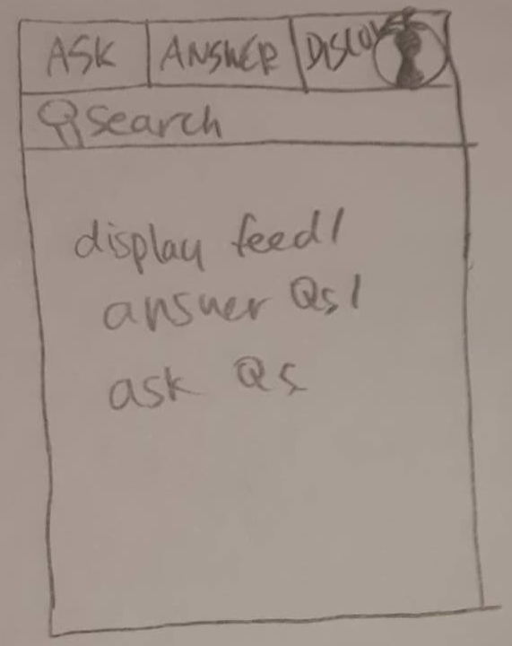
PROBLEM 1 | DIFFICULTIES IN NAVIGATING BETWEEN TASKS
BEFORE
AFTER
We had a main page where users could choose what they would like to do. All the interviewees had difficulties
switching from one
task to the other.
They had to press
back button multiple
times to reach the
home page.
Instead of using the main page, we implemented a bright-color navigation bar on the top part. Users would be able
to know which
features they could
use and navigate
between the tasks
more easily.

Slide 6
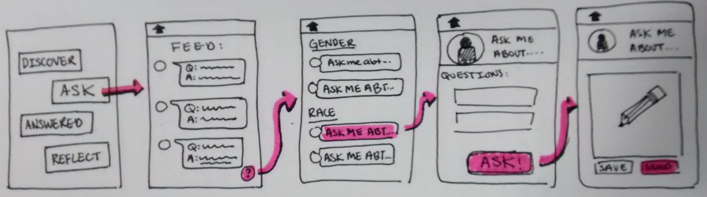
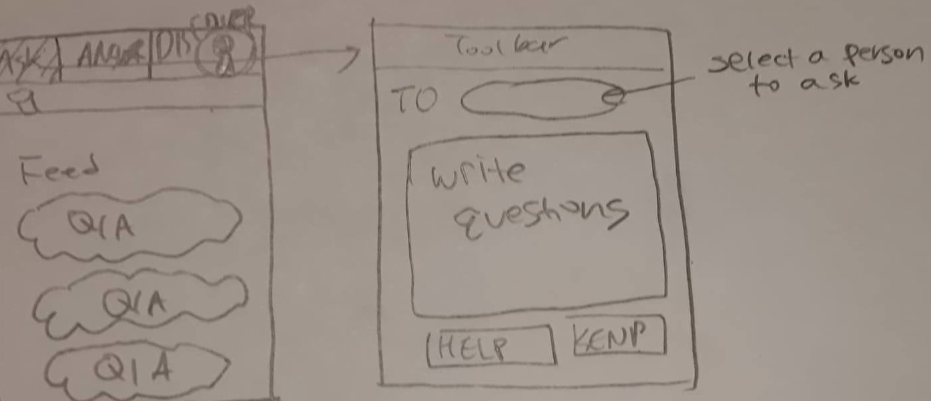
PROBLEM 2 | DIFFICULTIES IN ASKING QUESTIONS
BEFORE
c
There were too many screens that the user has to go through to ask a question.
AFTER
As the users would expect to ask question right after they enter the ask feature, the other scenes are unnecessary. We thus got rid of the intermediate scenes -- when the user is on the “ask” page, they can just ask questions.

Slide 7
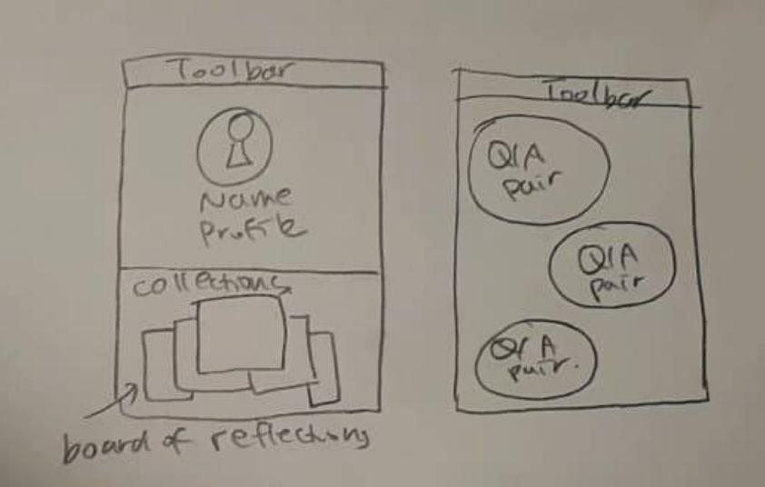
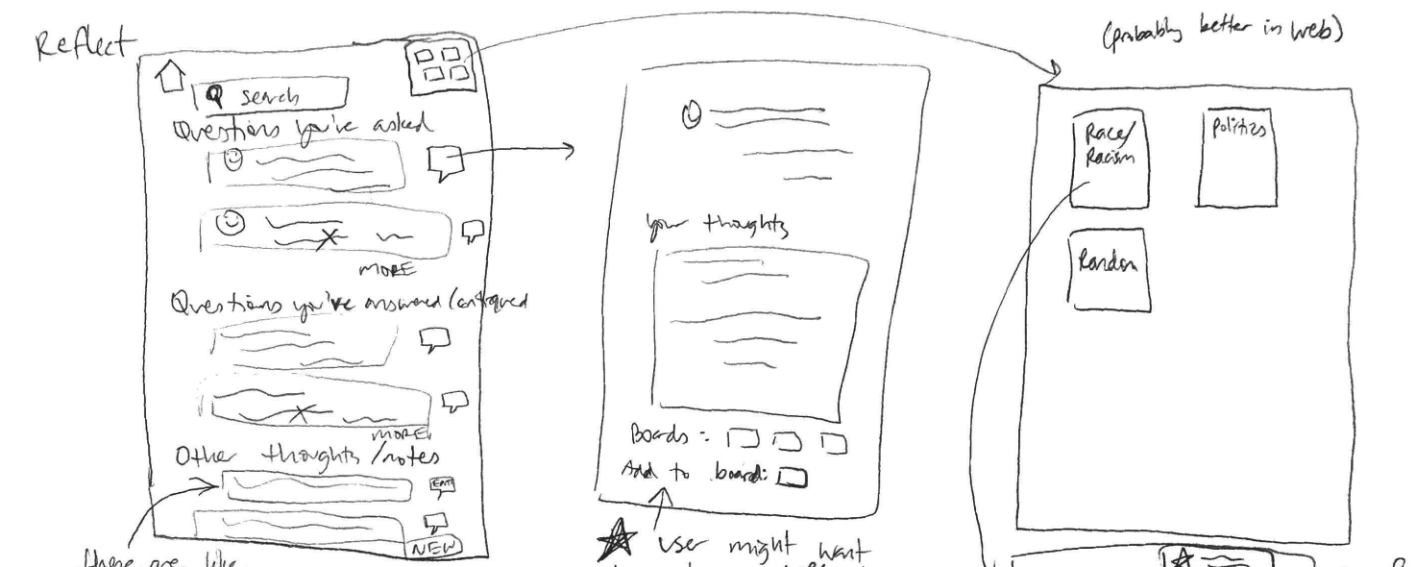
PROBLEM 3 | DIFFICULTIES IN USING THE REFLECTION PAGE
BEFORE
AFTER
Users were confused why they have to save questions in the reflection page -- they wanted to save questions directly from the questions and answers feed. Reflection page has too many features, so users were not able to utilize the core functionality -- crafting and saving their new thoughts.
We integrated reflection page with the profile functionality. Rather than having the reflection page, users can directly save questions and answers from their feeds and view them in the profile.

Slide 8

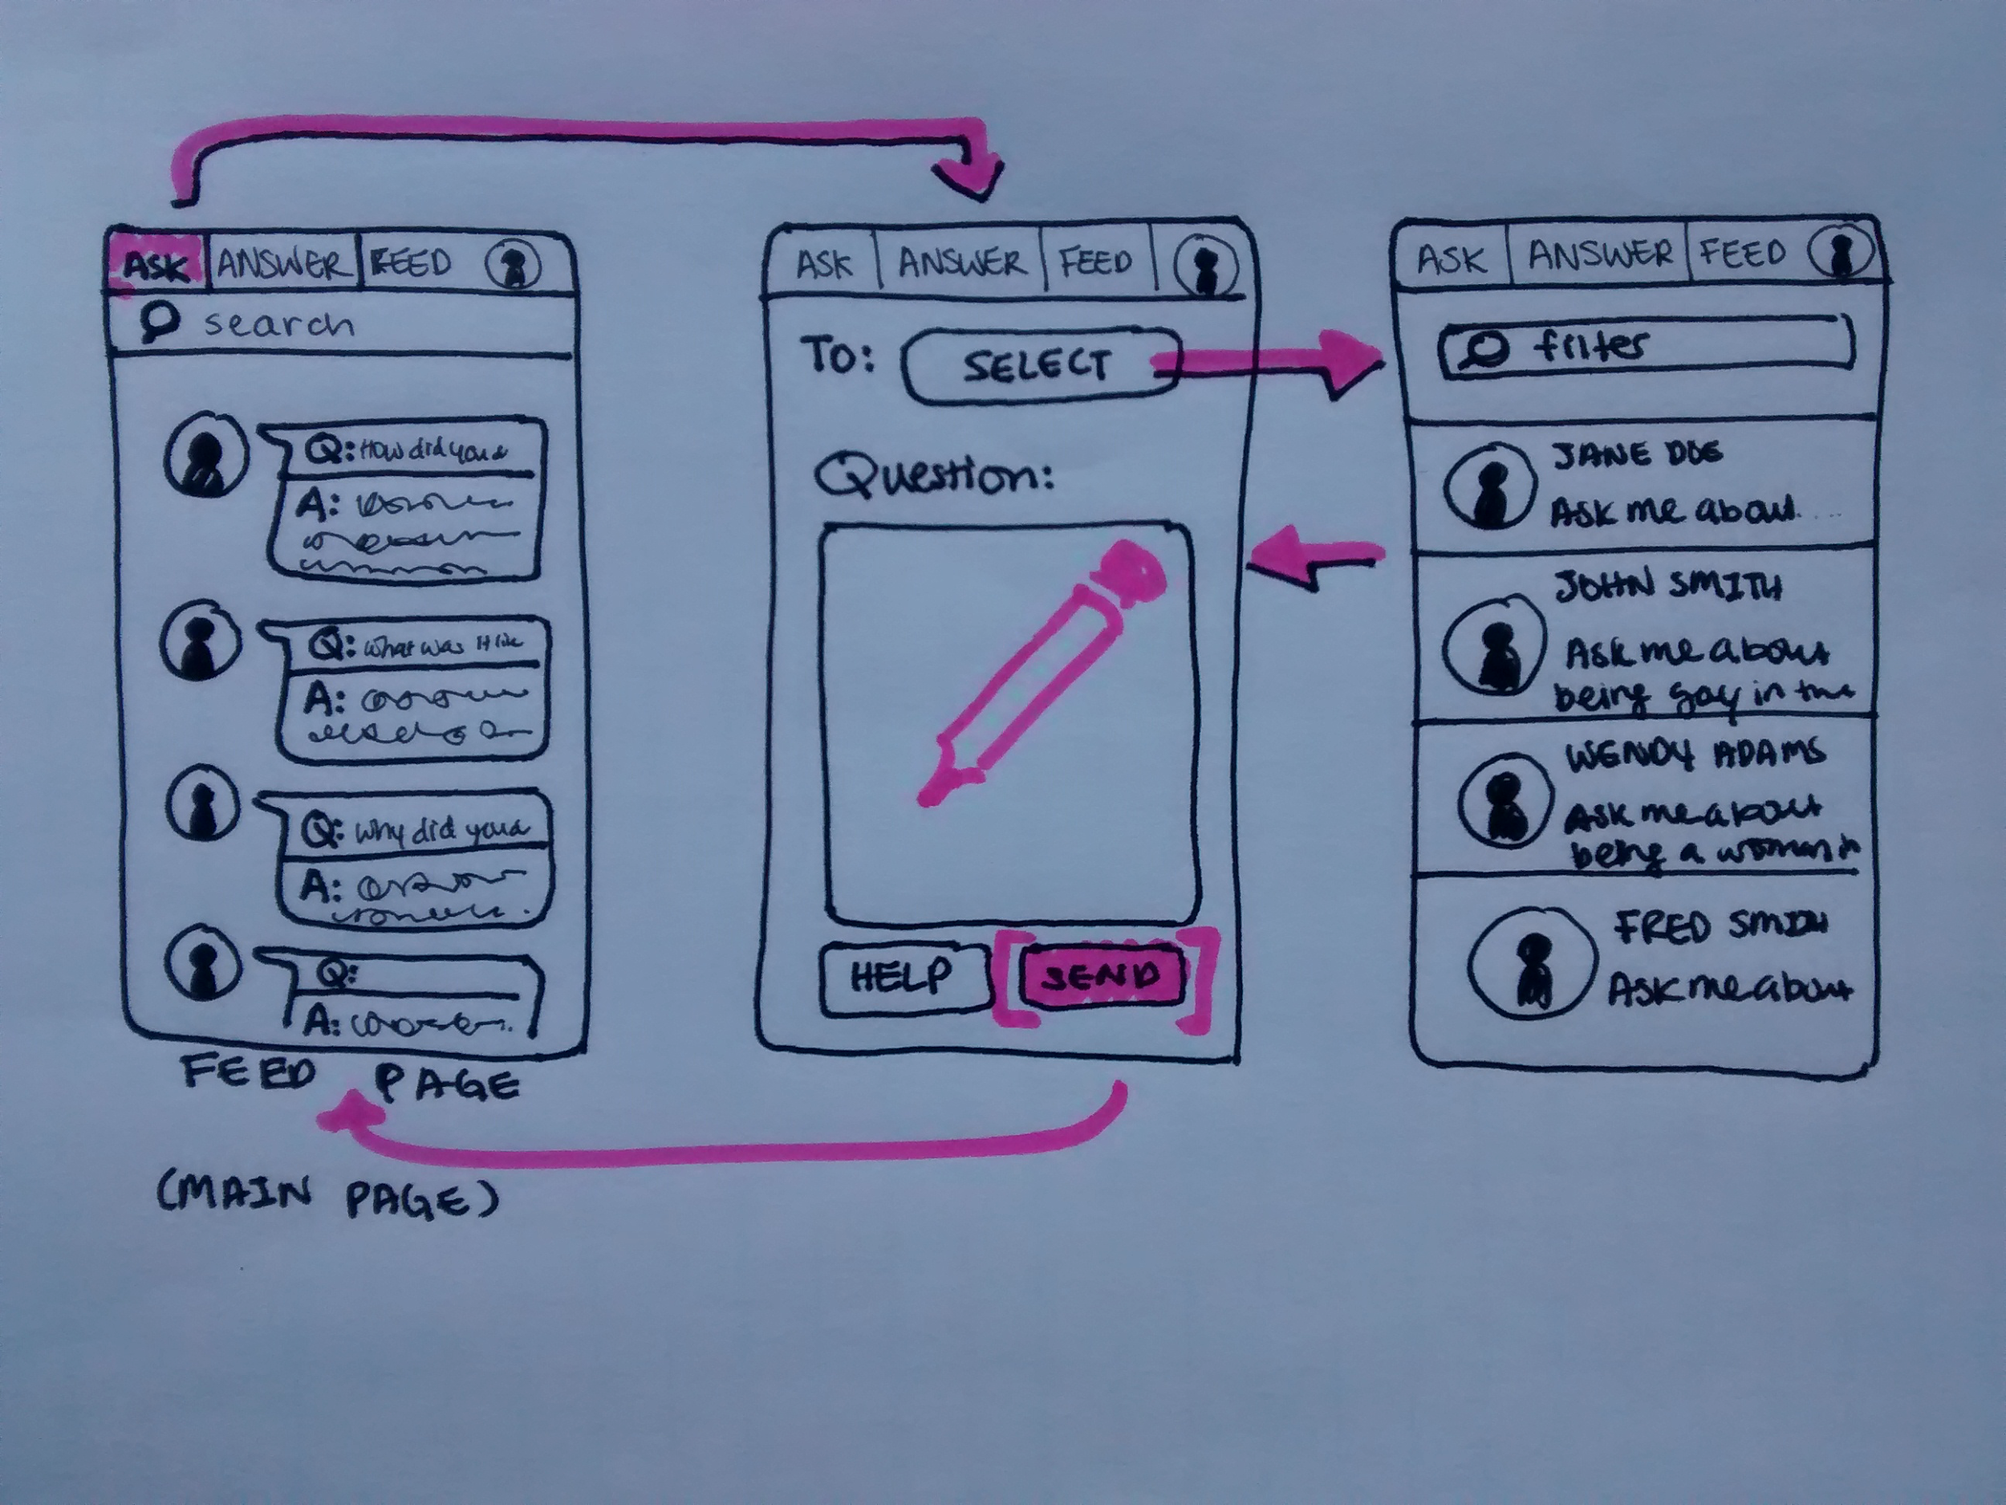
TASK FLOW 1 (MARVEL) | ASK AN ANONYMOUS QUESTION
Navigation issues

Slide 9
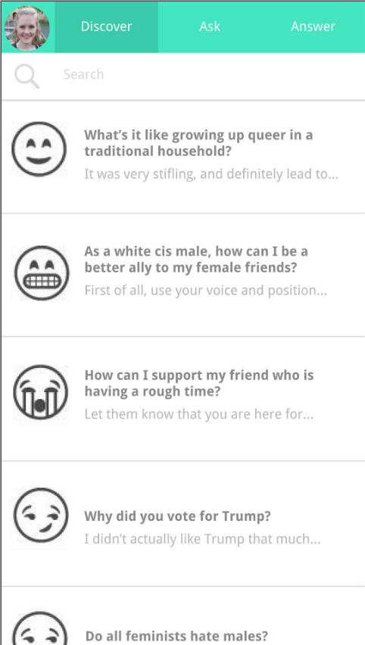
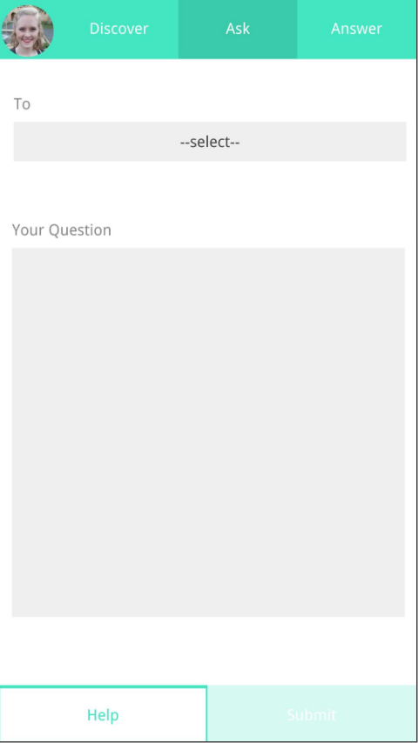
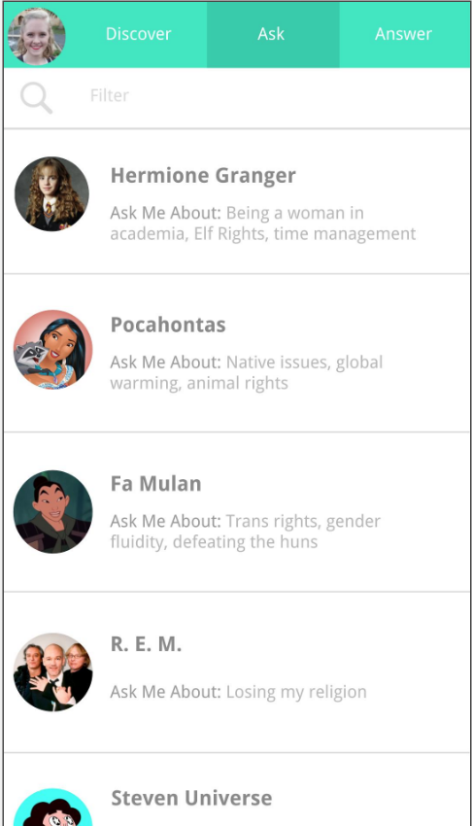
TASK FLOW 1 | ASK AN ANONYMOUS QUESTION
MAIN PAGE
DEFAULT “ASK” PAGE
“SELECT PAGE”

Slide 10
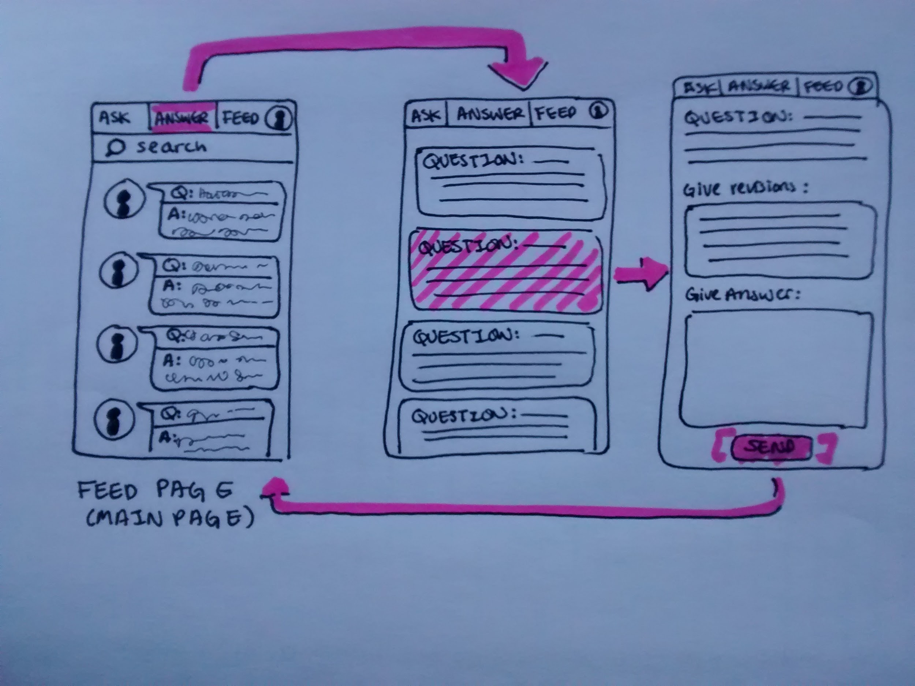
TASK FLOW 2 | ANSWER/CRITIQUE A QUESTION

Slide 11
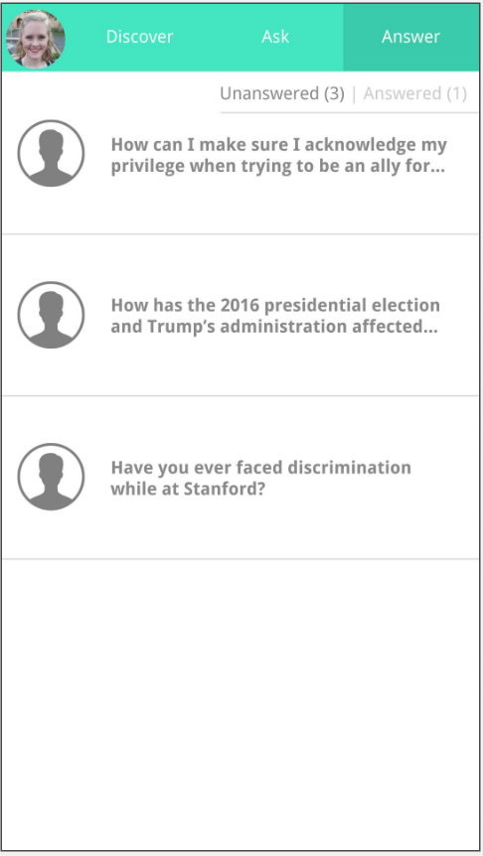
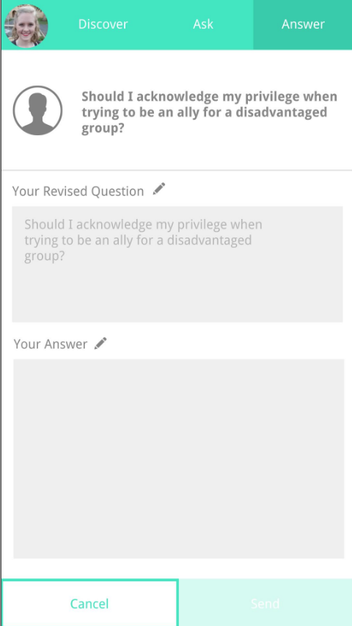
TASK FLOW 2 (MARVEL) | ANSWER/CRITIQUE A QUESTION
MAIN PAGE
DEFAULT “ANSWER” PAGE

Slide 12
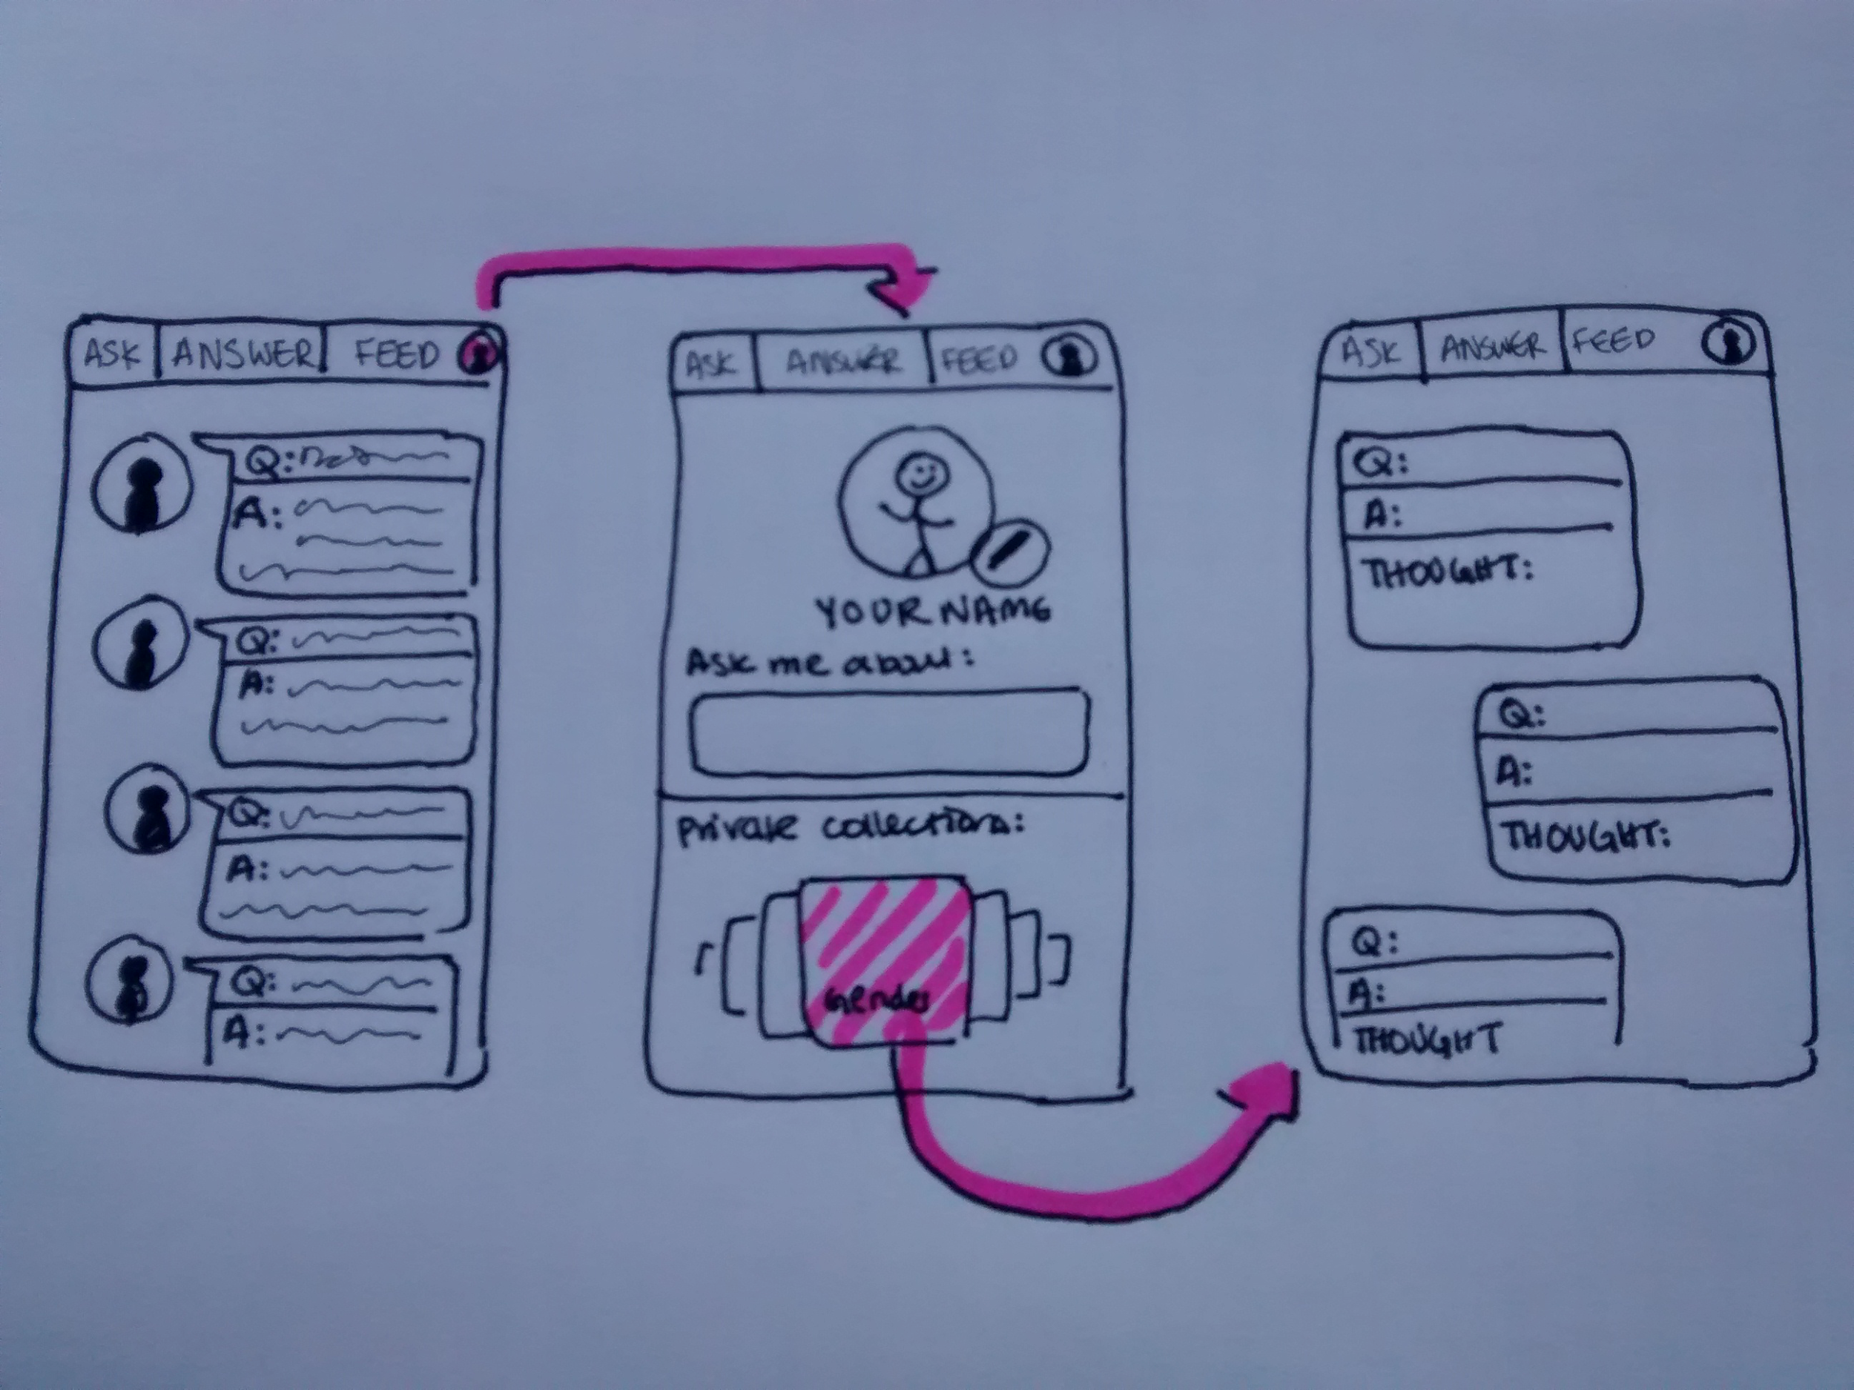
TASK FLOW 3 | REFLECT ON WHAT YOU LEARNED

Slide 13
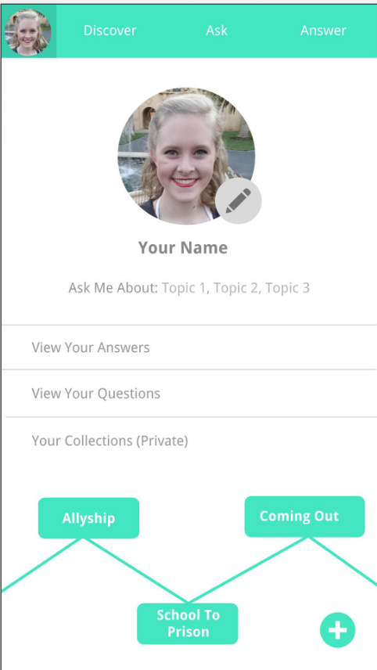
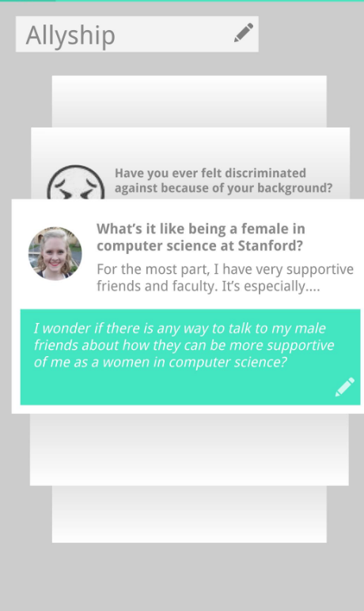
TASK FLOW 2 (MARVEL) | ANSWER/CRITIQUE A QUESTION
MAIN PAGE
PROFILE
COLLECTIONS OF REFLECTIONS

Slide 14
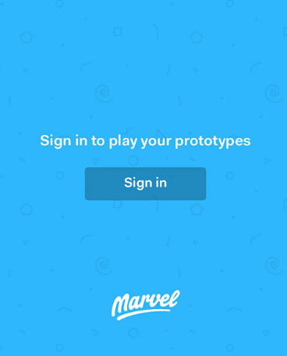

PROTOTYPING TOOLS
MAKING SCREENS
PROTOTYPING
PROS
Can duplicate the transitions on multiple screens
Can comment on the prototypes
CONS
Changes that users made are not persistent -- they do not remain in the DB
Impossible for marvel to remember the previous actions and make transitions accordingly
GOOGLE DRAWINGS
MARVEL

Slide 15

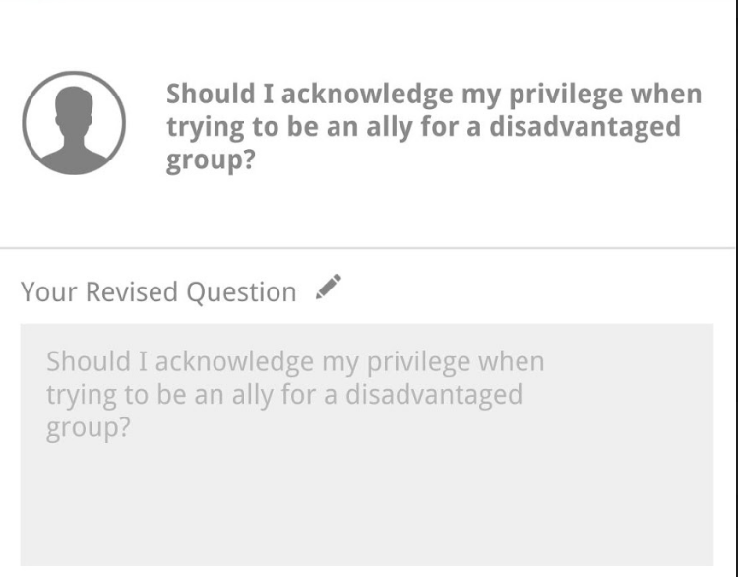
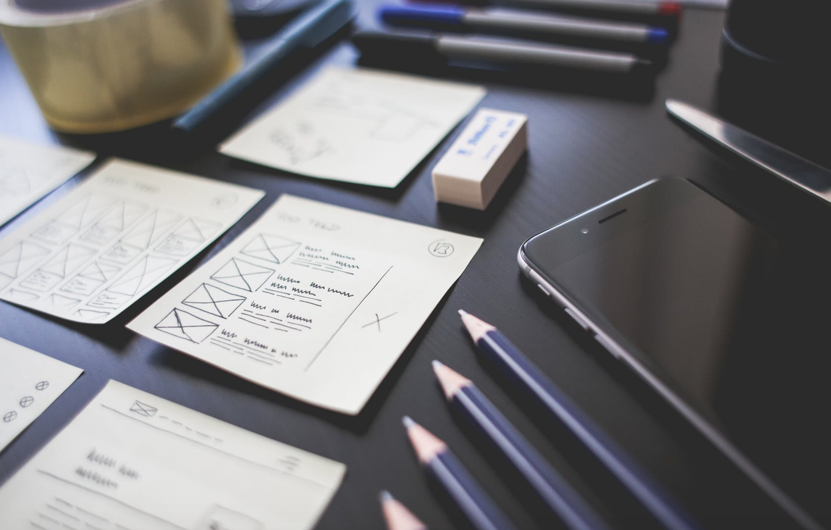
Limitations/tradeoffs of the current prototype
Decided on using only one flow -- users would not be able to choose among different orders
The flow for revising questions is very constrained because we did not want to lose users with complex functionality
Concentrated more on fixing design problems and addressing the challenges rather than giving an app unique styles
Changes are not persistent because we did not use any database

Slide 16
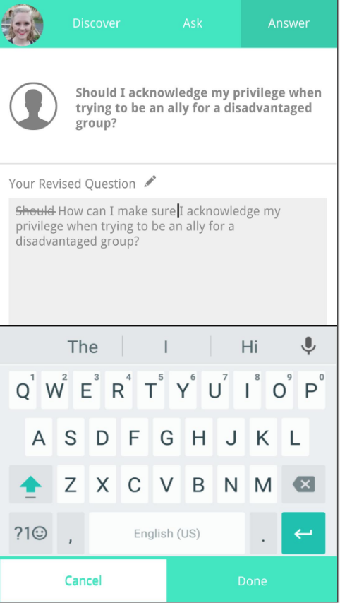
Wizard of Oz / Hardcoded features
Hardcoded #1
Most of the questions and answers were hardcoded because we would not have user-generated input in the prototype.
Hardcoded #2
When the user is revising the question, the user will tap on the textbox. Here, we hardcoded where to highlight, where to cross out, and what to write in the textbox.
Hardcoded #3
We use keyboard to ask user to type. Once user taps any of the keys on the keyboard, we filled the textbox with hardcoded text.

